Slide 1
Week 13: Processes, Context Switching, Threads
BHOS C Programming, Ahad Suleymanli

Slide 2
Outline
OUTLINE
Process Concept
Operations on Processes
Context
Context Switching
Parallel execution
Threads vs Processes
Thread Libraries
Thread safety
2

Slide 3
Process Management
A process is a program in execution.
Unit of work in the system
(Process is an active entity a program is passive).
Process executes instructions sequentially, one at a time, until completion
Process needs resources to accomplish its task
CPU, memory, I/O, files
Typically system has many processes running concurrently
Some of them may be OS processes
Upon termination, resources are released
Vi
Firefox
Gcc
31

Slide 4
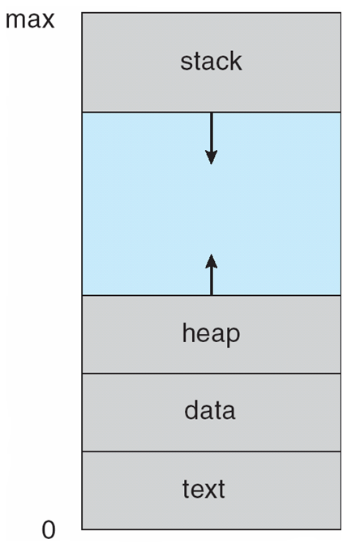
Process: program in execution
CPU
(Physical)
Main Memory
(RAM)
registers
PSW
PC
IR
CPU state of the process
(CPU context)
process address space
(currently used portion of the address space must be in memory)
6

Slide 5
Multiple Processes
one program counter
Process
A
processes
Three program counters
Process
B
C
Process
A
Process
B
Process
C
B
Process
C
A
time
Conceptual model
of three different processes
what is
happening physically
one process executing at a time
7

Slide 6
Process in Memory
Stack segment (holds the called function parameters,
local variables, return values)
Storage for dynamically created
variables
Data segment (includes global variables, arrays, etc., you use)
Text segment (code segment)
(instructions are here)
A process needs this memory content to run
(called address space; memory image)
8

Slide 7
Process Address Space
A process can only access its address space
Each process has its own address space
Kernel can access everything
9

Slide 8
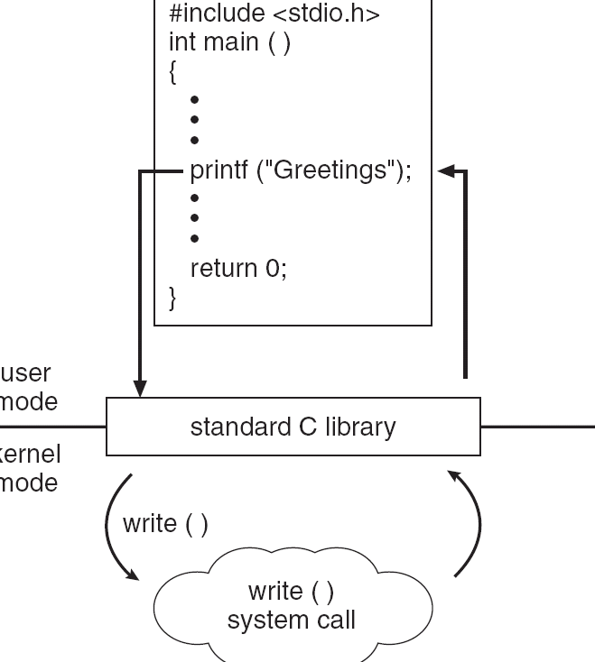
Example of Kernel At Work (Syscal)
C program invoking printf() library call, which calls write() system call
19

Slide 9
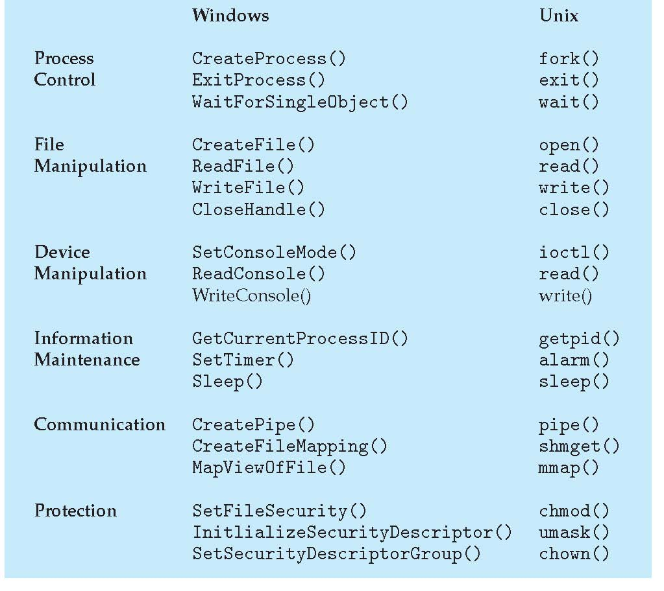
Examples of Windows and Unix System Calls
21

Slide 10
Process State
As a process executes, it changes state
new: The process is being created
running: Instructions are being executed
waiting: The process is waiting for some event to occur
ready: The process is waiting to be assigned to a processor
terminated: The process has finished execution
In a single-CPU system, only one process may be in running state; many processes may be in ready and waiting states.

Slide 11
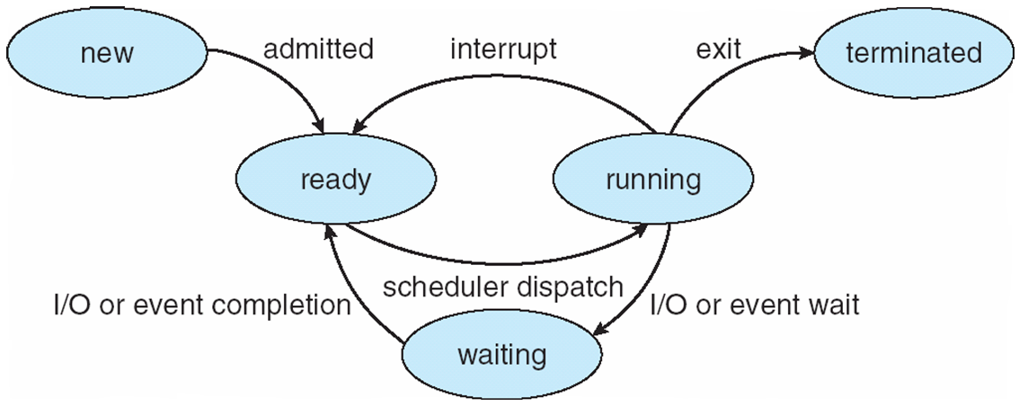
Diagram of Process State

Slide 12
Process Control Block
Information associated with each process
Process state (ready, running, waiting, etc)
Program counter (PC)
CPU registers
CPU scheduling information
Priority of the process, etc.
Memory-management information
text/data/stack section pointers, sizes, etc.
pointer to page table, etc.
Accounting information
CPU usage, clock time so far, …
I/O status information
List of I/O devices allocated to the process, a list of open files, etc.

Slide 13
Process Representation in Linux
In Linux kernel source tree, the file include/linux/sched.h contains
the definition of the structure task_struct, which is the PCB for a process.
struct task_struct {
long state; /* state of the process */
….
pid_t; pid /* identifier of the process */
…
unisgned int time_slice; /* scheduling info */
…
struct files_struct *files; /* info about open files */
….
struct mm_struct *mm; /* info about the address space of this process */
…
}

Slide 14
PCBs
Process 1
Process 2
Process 3
Process N
stack
stack
stack
stack
process
address space
data
data
data
data
text
text
text
text
PCB
1
PCB
2
PCB
3
PCB N
Kernel Memory
Kernel mains a PCB for each process. They can be linked together in various queues.

Slide 15
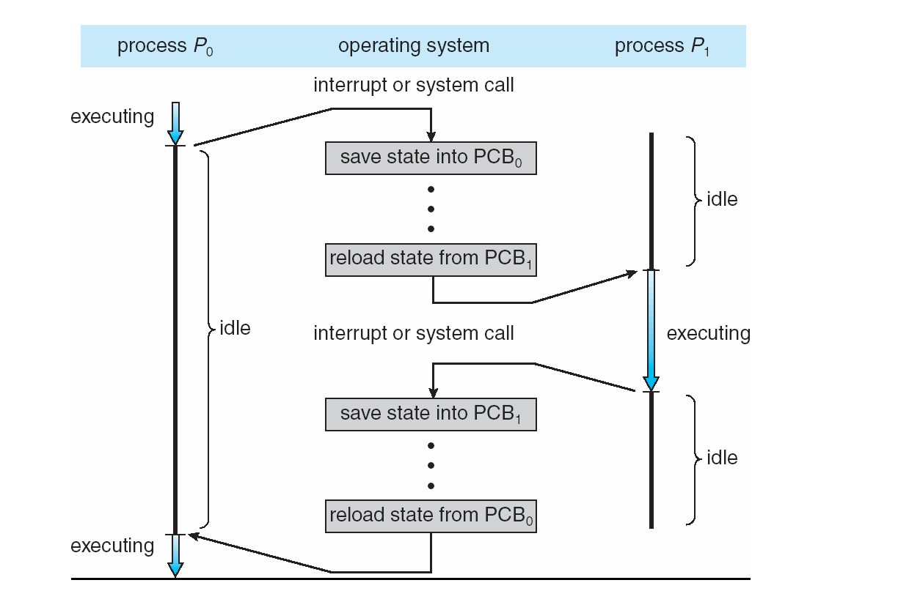
CPU Switch from Process to Process

Slide 16
Process Behavior
Processes can be described as either:
I/O-bound process – spends more time doing I/O than computations, many short CPU bursts
CPU-bound process – spends more time doing computations; few very long CPU bursts
CPU burst: the execution of the program in CPU between two I/O requests (i.e. time period during which the process wants to continuously run in the CPU without making I/O)
We may have a short or long CPU burst.
I/O bound
CPU bound
waiting
waiting

Slide 17
Context Switch
When CPU switches to another process, the system must save the state of the old process and load the saved state for the new process via a context switch
Context of a process represented in the PCB
Context-switch time is overhead; the system does no useful work while switching
Time dependent on hardware support

Slide 18
Processes vs Threads
Processes are spawned with the help of the kernel using fork()
Threads are spawned with the help of the kernel using clone()

Slide 19
More differences
If your main process creates a 2nd process, now you have two different address spaces (stack, heap, data, text) in memory
If your main process creates a 2nd thread now you share your address space except the stack!

Slide 20
Threads

Slide 21
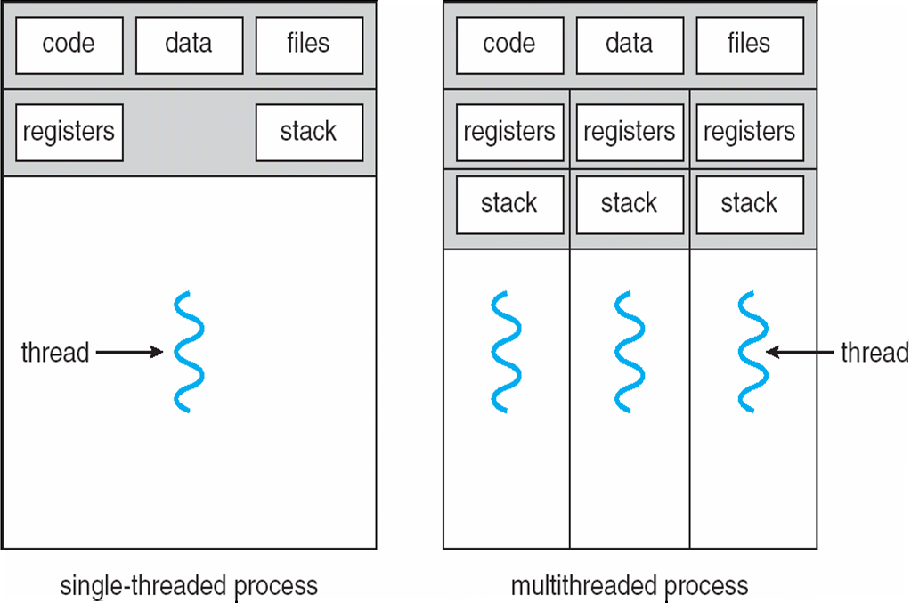
Single and Multithreaded Processes
10

Slide 22
Multithreading Concept
function1(…)
{
….
{
function2(…)
{
….
{
main()
{ ….
thread_create (function1 ,…);
….
thread_create (function2, …);
….
thread_create (function1, …);
….
}
thread1
thread2
thread3
thread4
9

Slide 23
Multicore programming and multithreading challenges
Multicore systems putting pressure on programmers.
Threading can utilize Multicore systems better, but it has come challenges
Threading Challenges include
Dividing activities
Come up with concurrent tasks
Balance
Tasks should be similar importance and load
Data splitting
Data may need to be split as well
Data dependency
Data dependencies should be considered; need synchronization of activities
Testing and debugging
Debugging is more difficult
11

Slide 24
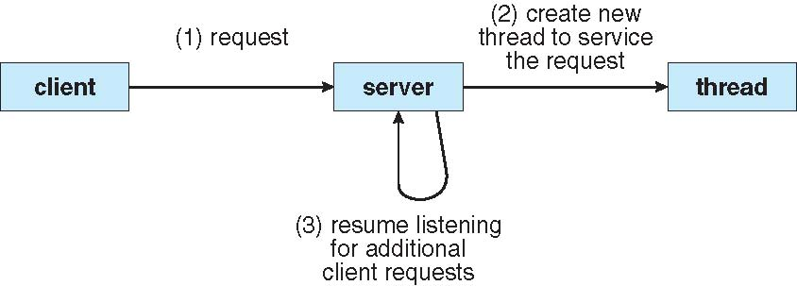
Multithreaded Server Architecture
12

Slide 25
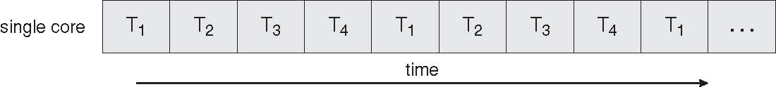
Concurrent Execution on a Single-core System
13

Slide 26
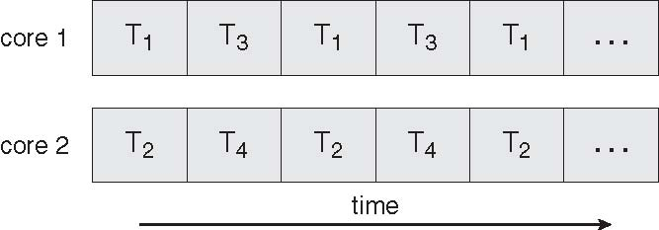
Parallel Execution on a Multicore System
14

Slide 27
Threading Support
15

Slide 28
Threading Support
Multithreading can be supported by:
User level libraries (without Kernel being aware of it)
Library creates and manages threads (user level implementation)
Kernel itself
Kernel creates and manages threads (kernel space implementation)
No matter which is implemented, threads can be created, used, and terminated via a set of functions that are part of a Thread API (a thread library)
Three primary thread libraries: POSIX threads, Java threads, Win32 threads
16

Slide 29
Thread Libraries
Thread library provides programmer with API for creating and managing threads
Programmer just have to know the thread library interface (API).
Threads may be implemented in user space or kernel space.
library may be entirely in user space or may get kernel support for threading
24

Slide 30
Pthreads Library
May be provided either as user-level or kernel-level
A POSIX standard (IEEE 1003.1c) API for thread creation and synchronization
API specifies behavior of the thread library, implementation is up to development of the library
Common in UNIX operating systems (Solaris, Linux, Mac OS X)
25

Slide 31
Pthreads Example
We will show a program that creates a new thread.
Hence a process will have two threads :
1 - the initial/main thread that is created to execute the main() function (that thread is always created even there is no support for multithreading);
2 - the new thread.
(both threads have equal power)
The program will just create a new thread to do a simple computation: will sum all integers upto a given parameter value
sum = 1+2+…+parameter_value
The main thread will wait until sum is computed into a global variable.
Then the main thread will print the result.
26

Slide 32
Pthreads Example
#include <pthread.h>
#include <stdio.h>
int sum; /* shared sum by threads – global variable */
void *runner (void *param); /* thread start function */
27

Slide 33
Pthreads Example
int main(int argc, char *argv[]){
pthread_t tid; /* id of the created thread */
pthread_attr_t attr; /* set of thread attributes */
if (argc != 2) {
fprintf (stderr, “usage: a.out <value>\n”);
return -1;
}
if (atoi(argv[1]) < 0) {
fprintf (stderr, “%d must be >= 0\n”, atoi(argv[1]);
return -1;
}
pthread_attr_init (&attr);
pthread_create (&tid, &attr, runner, argv[1]);
pthread_join (tid, NULL);
printf (“sum = %d\n”, sum);
}
28

Slide 34
Pthreads Example
int main(int argc, char *argv[]){
pthread_t tid; /* id of the created thread */
pthread_attr_t attr; /* set of thread attributes */
if (argc != 2) {
fprintf (stderr, “usage: a.out <value>\n”);
return -1;
}
if (atoi(argv[1]) < 0) {
fprintf (stderr, “%d must be >= 0\n”, atoi(argv[1]);
return -1;
}
pthread_attr_init (&attr);
pthread_create (&tid, &attr, runner, argv[1]);
pthread_create (&tid, &attr, runner, argv[1]);
pthread_join (tid, NULL);
pthread_join (tid2, NULL);
printf (“sum = %d\n”, sum);
}
34

Slide 35
Pthreads Example
void *runner (void *param)
{
int i;
int *upper;
upper = (int*)(param);
sum = 0;
for (i = 1; i <= upper; ++i)
sum += i;
pthread_exit(0);
}
29

Slide 36
Pthreads Example
int main(…)
{
bool stop = false;
…
….
pthread_create(&tid,…,runner,&stop);
pthread_join(tid);
. printf (…, sum, …);
}
runner (…) {
while(1)
{
if (*stopPtr == true){
pthread_exit();
}
}
….
sum = …
pthread_exit();
{
thread1
thread2
wait
36

Slide 37
Compiling and running the program
You can put the above code into a .c file, say mysum.c
In order to use the Pthreads functions, we need to include pthread.h header file in our program (as shown in previous slides)
We also need to link with the pthread library (the Pthreads API functions are not implemented in the standard C library). The way to do that is using the –l option of the C compiler. After –l you can provide a library name like pthread.
Hence we can compile+link our program as follows:
gcc -Wall -o mysum -lpthread mysum.c
Then we run it as (for example):
./mysum 6
It will print out 21
31

Slide 38
Other Threading Issues
32

Slide 39
Interpreted Languages
Java threads are managed by the JVM
C# threads are managed by CLR (common language runtime by MS)
Python threads are managed by CPython interpreter
(python threads are terrible, use multiprocessing if possible)
Typically implemented using the threads model provided by underlying OS

Slide 40
Threading Issues
Thread cancellation of target thread
Asynchronous or deferred
Signal handling
Thread pools
Thread-specific data
34

Slide 41
Thread Cancellation
Terminating a thread before it has finished
Need at various cases
Two general approaches:
Asynchronous cancellation terminates the target thread immediately
Deferred cancellation allows the target thread to periodically check if it should be cancelled
Cancelled thread has sent the cancellation request
36

Slide 42
Signal Handling
If a signal is send to Multithread Process, who will receive and handle that?
In a single thread process, it is obvious.
42

Slide 43
Examples of Linux Signals
Ctrl+C: SIGINT (terminate)
Ctrl+D (sends EOF to stdin)
Ctrl+Z: SIGSTP (stosuspends the process)
ps -aux | less
kill -9 {process id}

Slide 44
Thread Pools
Create a number of threads in a pool where they await for work
Advantages:
Faster
Limit the count of threads:
Allows the number of threads in the application to be bound to the size of the pool
38

Slide 45
From Single-threaded to Multithreaded
Many programs are written as a single threaded process.
If we try to convert a single-threaded process to multi-threaded process, we have to be careful about the following:
the global variables
the library functions we use
39

Slide 46
From Singlethread to Multithreaded
int status; // a global variable
func1(…) {
….
status = …
do_something_based_on(status);
}
func2(…) {
…
status = …
do_something_based_on(status);
}
main() {
….
func1 (…);
func2 (…);
}
This is a single threaded program
40

Slide 47
From Singlethread to Multithreaded
int status;
func1(…) {
….
status = …
do_something_based_on(status);
}
func2(…) {
…
status = …
do_something_based_on(status);
}
main() {
….
thread_create(…, func1, …);
thread_create(…, func2, …);
}
We can have problem here.
Just after func1 of thread 1 updated status, a thread switch may occur and 2nd thread can run and update status.
Then thread 1 will run again, but will work with a different status value.
Wrong result!
41

Slide 48
From Single-threaded to Multithreaded
Scope of variables:
Normally we have: global, local
With threads we want: global, local, and thread-specific
thread-specific: global inside the thread (thread-wide global), but not global for the whole process. Other threads can not access it. But all functions of the thread can.
But we don’t have language support to define such variables.
C can not do that.
Therefore thread API has special functions that can be used to create such variables – data.
This is called thread specific data.
42

Slide 49
Note on Global Variables
In this course we will not use any kind of global variables (except constants)
Global = evil
Instead we will learn to use references to variables created on the heap

Slide 50
Thread Specific Data
Allows each thread to have its own copy of data
Each thread refers to the data with the same name.
create_global (“bufptr”); // create pointer to such a variable
set_global (“bufptr”, &buf); // set the pointer
bufptr = read_global (“bufptr”); // get the pointer to access
43

Slide 51
From Singlethread to Multithreaded
Many library procedures may not be reentrant.
They are not designed to have a second call to itself from the same process before it is completed (not re-entrant).
(We are talking about non-recursive procedures.)
They may be using global variables. Hence may not be thread-safe.
We have to be sure that we use thread-safe (reentrant) library routines in multi-threaded programs we are developing.
44

Slide 52
Context switching re-visited
Process 1
Process 2
Process 3
Process N
stack
stack
stack
stack
process
address space
data
data
data
data
text
text
text
text
PCB
1
PCB
2
PCB
3
PCB N
Kernel Memory

Slide 53
Context switching re-visited cont.d
CPU
(Physical)
Main Memory
(RAM)
registers
PSW
PC
IR
CPU state of the process
(CPU context)
process address space
(currently used portion of the address space must be in memory)

Slide 54
Context switching re-visited cont.d
The register set, stacks, and private storage area are known as the context of the threads

Slide 55
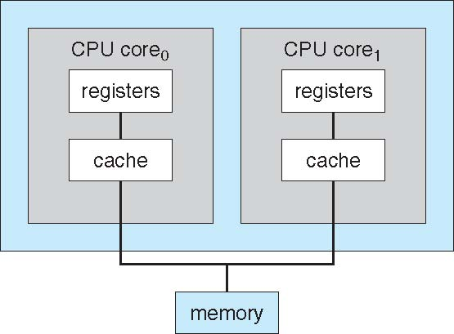
A Dual Core Design
21

